Slide 1
Project Lisa
A smart shopping solution

Slide 2
Idea behind Lisa
Automate Shopping
Making it easier for customers to buy stuffs
Speed up shopping process

Slide 3
Components:
Mobile Application
Database
Microcontroller

Slide 4

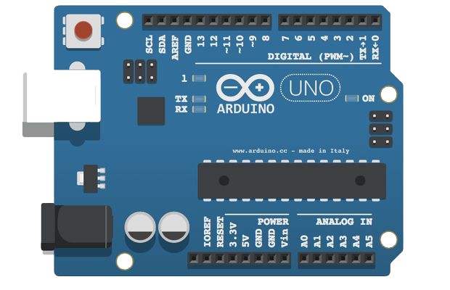



Slide 5
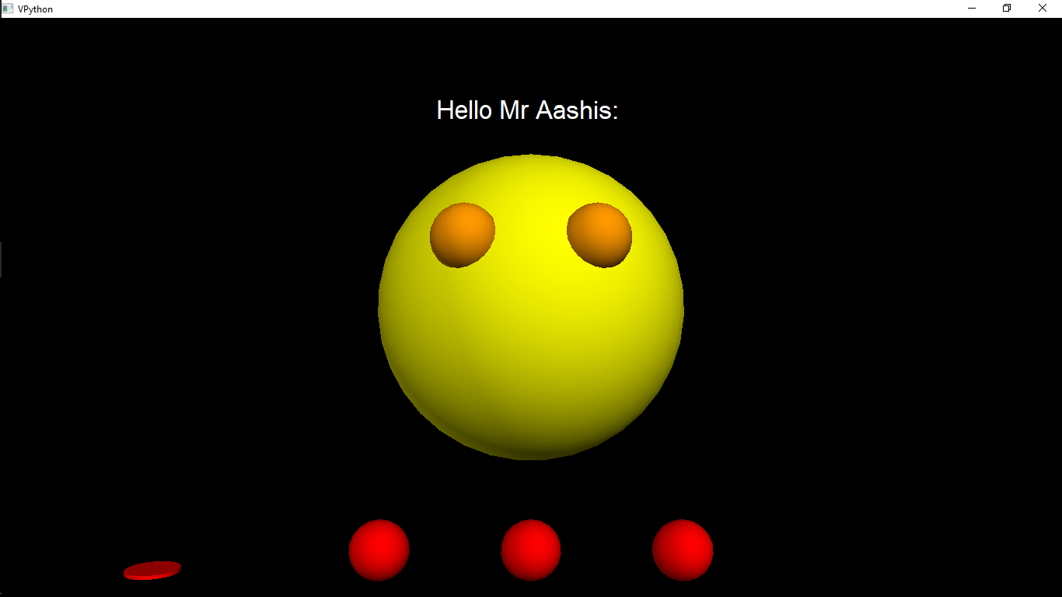
Introduction to Lisa
Features:
Facial Detection.
Able to learn from human interaction.
Keep in sync with various devices .
Voice Controlled

Slide 6
Facial Recognition:

Slide 7
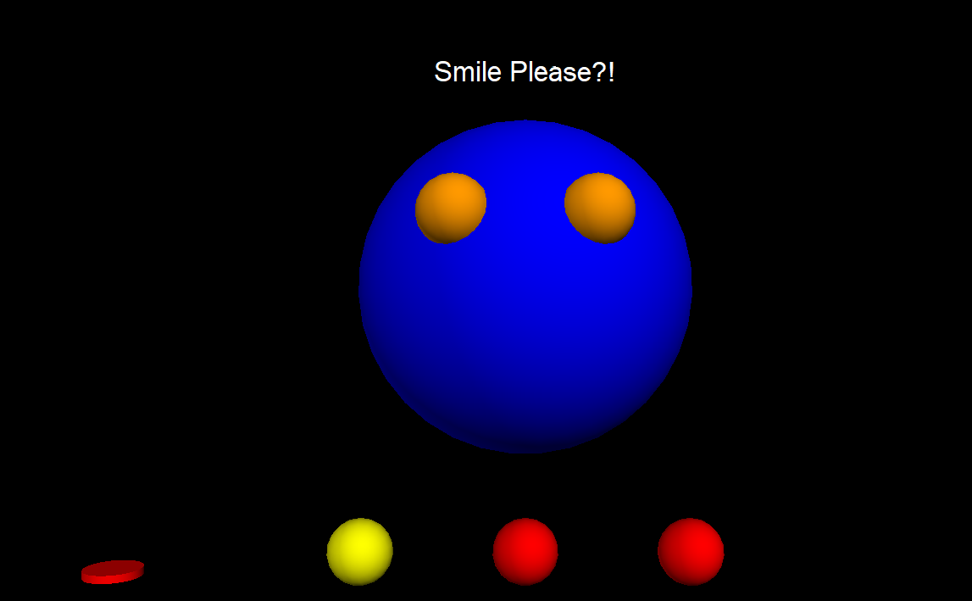
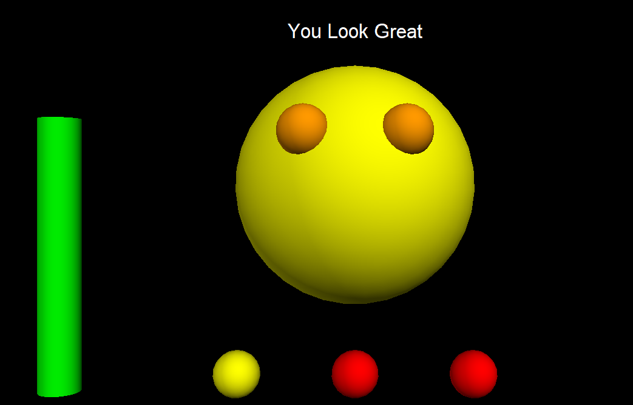
Lisa Detects your emotions live
Lisa knows when you are sad
Lisa can detect when you are happy

Slide 8
Sync your home devices live to Lisa

Slide 9
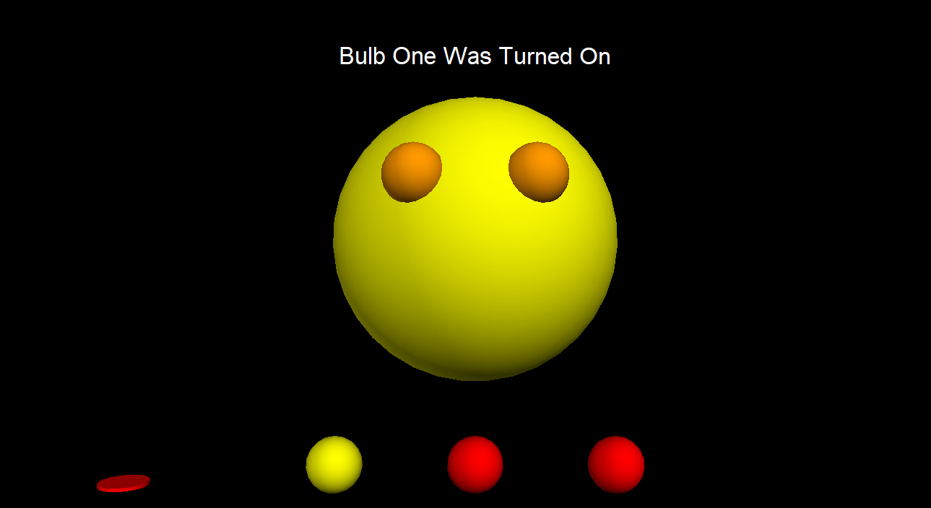
Lisa is capable of syncing devices to her and know when they are turned off or on

Slide 10
Buying and selling with Lisa is much interactive and easy

Slide 11
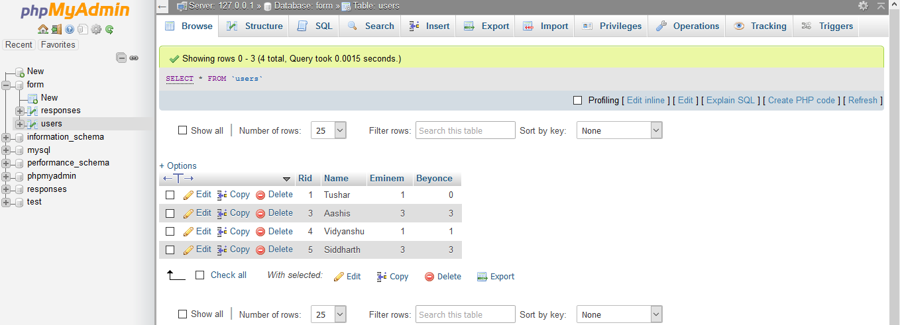
Lisa has a database and knows her customers

